Slide 1
Truth Tables for Arguments and Basics of Predicate Logic
Mirko Farina
Assistant Professor
Innopolis University
* I do not claim authorship for all texts and pictures in the presentation.

Slide 2




SUMMARY OF PREVIOUS LECTURE
Truth Tables for Propositions
What is a truth table and how to build a truth table
Analyse compound propositions
Classify propositional statements
Compare propositional statements
2

Slide 3





3

Slide 4




















4

Slide 5
TODAY’S PLAN
Truth Tables for Basic Arguments
Introduction to Predicate Logic
And Differences between Propositional and Predicate Logic
3. Symbols and Translation in Predicate Logic
5

Slide 6

Truth Tables for Basic Arguments
ARGUMENT = Premises -> Conclusion
Categorical Logic = 2 standard premises + conclusion (syllogism)
Propositional Logic = multiple premises + conclusion (more powerful tool to analyse complicated arguments, sort of arguments we come across in our daily life)
6

Slide 7
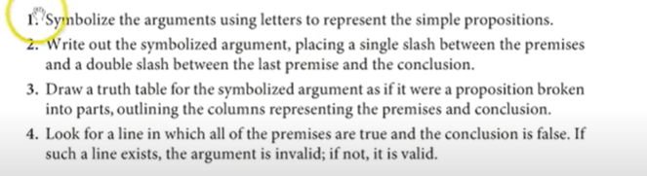
7

Slide 8
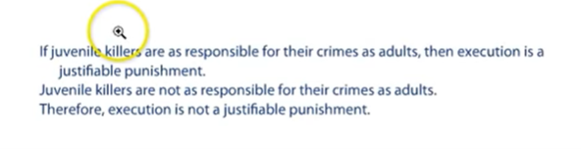









8

Slide 9








9

Slide 10
RECALL, STEPS:
INDIVIDUATE PREMISES AND CONCLUSION
TRANSLATE
2. PUT SLASH/ES
3. BUILD TRUTH TABLE
4. COMPUTE TRUTH TABLE
5. LOOK FOR INVALID LINE
10

Slide 11















11

Slide 12
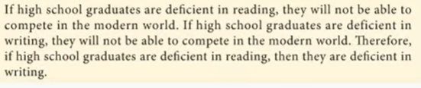













12

Slide 13



























13

Slide 14
2. Introduction to Predicate Logic (FIRST ORDER LOGIC)
Consider the following two statements:
• Katerine Zeta Jones is rich and beautiful
• If a woman she is either rich or famous, she is happy
• Therefore, Katerine Zeta Jones is happy
It looks “logical” to deduce that therefore, Katerine Zeta Jones is happy, However, this is too complicated for propositional logic…
We need new tools
14

Slide 15


PREDICATE LOGIC: Key logic system we utilize today, you use it every day in computer science.
Powerful because it combines the most important elements of categorical and propositional logic, which means that by using it we are going to be able to use our basic logical operator and we are able to analyse particular/universal claim.
BASIC UNIT: PREDICATES
15

Slide 16
What is a predicate?
A predicate is the quality (essential, accidental) that is attributed to a subject
Reference previous example
Essential = female, woman
Accidental = richness
16

Slide 17





In predicate logic we symbolize both the subject and the predicate.
Predicate is going to be symbolized as a Front, Capital case letter,
whereas the subject is always going to be symbolized as a back lower case letter
17

Slide 18
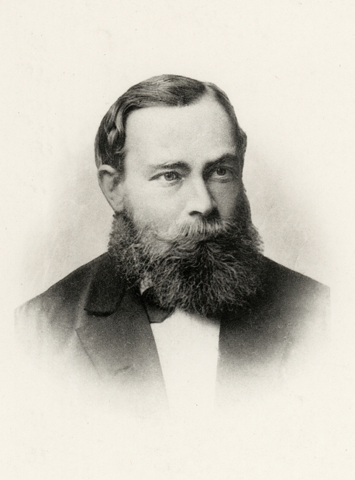
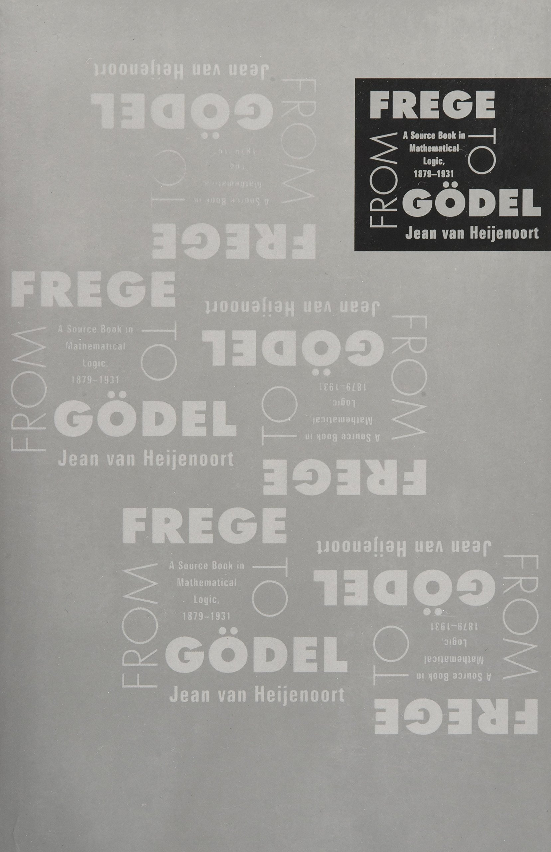



WHO DEVELOPED PREDICATE LOGIC?
Friedrich Ludwig Gottlob Frege
18

Slide 19


3. Symbols and Translation in Predicate Logic
John is happy
Socrates is foolish
John is happy and Socrates is foolish
19

Slide 20












If Paris is beautiful, then Andrei told the truth
Mirko is either a doctor or a lawyer
20

Slide 21








General Motor will prosper if either Nissan is crippled by a strike or Subaru declares bankruptcy
Kazan gets rain if and only if Moscow and Ufa gets snow
21

Slide 22









We can build lots of compound propositions this way but what about universal statements.
Recall in categorical logic we had two universal statements
All S are P; No S are P
How do we symbolize such statements in predicate logic?
We need to introduce a new tool
This is the Universal quantifier, x placed before a statement
All S are P =
No S are P
22

Slide 23













x, y, z = individual variables always allocated for something else
[You can’t use these variables to symbolize predicate or subject terms]
They can refer to anything in the universe, that is why they are universal variables
EXAMPLE: All skyscrapers are tall
EXAMPLE: No frogs are birds
23

Slide 24




3 key elements in predicate logic
Free Variables: those variables that occur in statements functions with no quantifier
2. Bound Variable: variable that occurs within a quantifier
3. Parenthesis: tell us what gets covered
24

Slide 25






WHAT ABOUT THE PARTICULAR STATEMENTS ?
WE NEED A SECOND NEW TOOL (Existential Quantifier)
SOME S ARE P (there is an x that exists, that x is in S and that S is also in P)
SOME S ARE NOT P (there is an x that exists, that x is in S and that S is not in P)
25

Slide 26







26

Slide 27






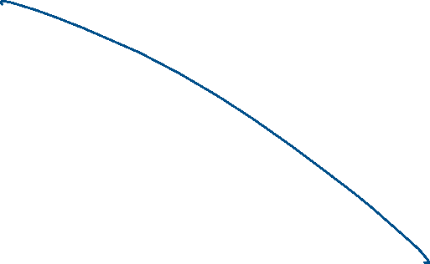



Slide 28









WE CAN NOW LITERALLY COMBINE THE WHOLE OF CATEGORICAL AND PROPOSITIONAL LOGIC TO ANALYSE VERY COMPLEX ARGUMENTS
SOME WOMEN ARE CEOs
SOME PEOPLE ARE NOT STUPID
27

Slide 29








HOW TO TRANSLATE OTHER STATEMENTS?
PRACTICE MAKES IT PERFECT
There are happy marriages
Every doctors looses sleep
Animals exist ->
Unicorns do not exist ->
28

Slide 30








Anything is conceivable
Only close friends were invited to the wedding
A few egomaniacs did not arrive on time
29

Slide 31















None but citizens are eligible to vote
Sea lions live in these caves
Sea lions are mammals
It is not the case that every scout girl sells cookies

Slide 32
WHAT DID YOU LEARN TODAY?
- HOW TO BUILD TABLES FOR COMPLEX ARGUMENTS IN PROPOSITIONAL LOGIC
-WHAT IS PREDIATE LOGIC
- THE ROOTS OF PREDICATE LOGIC
- HOW TO SYMBOLISE NATURAL LANGUAGE STATEMENTS INTO PREDICATE LOGIC
- HOW TO SYMBOLISE CATEGORICAL STATEMENTS IN PREDICATE LOGIC
- APPRECIATE THE POWER OF PREDICATE LOGIC
30

